Slide 1
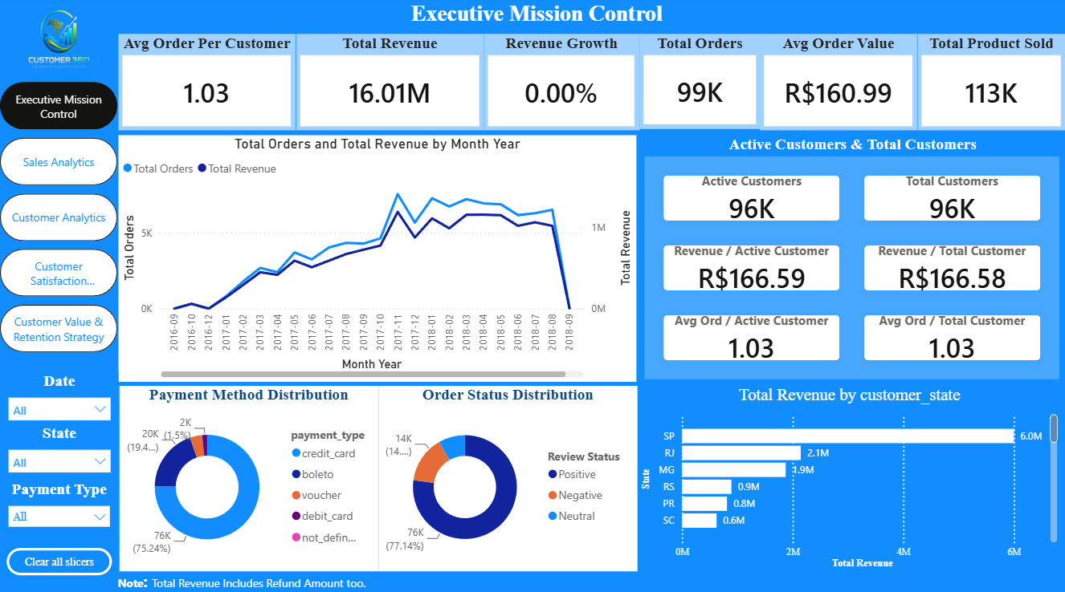
CUSTOMER 360 INTELLIGENCE
Brazilian E-Commerce Customer Analytics & Retention Dashboard
Tools
Power BI | DAX | Power Query
Dataset
Brazilian E-Commerce Public Dataset — Olist
PROJECT
Customer 360 Intelligence
Portfolio Project • 2026
Turning customer, sales, payment, and satisfaction data into actionable business insights.

Slide 2
BUSINESS PROBLEM & OBJECTIVES
The business needs a clear view of customer and sales performance to understand what drives revenue, why customers do not return, and where retention opportunities exist.
Objectives
01 — Sales Performance Track revenue, orders, products, and state-wise performance.
02 — Customer Behaviour Understand one-time vs repeat purchasing patterns.
03 — Customer Retention Identify churned customers and revenue at risk.
04 — Customer Satisfaction Analyse reviews, satisfaction levels, categories, and sellers.
05 — Growth Opportunities Identify high-value customers and repeat-purchase opportunities.
DATA Sales • Customers • Payments • Reviews
ANALYSIS
Customer Behaviour • Churn • Satisfaction
INSIGHTS
Revenue Drivers • Retention • Opportunities
ACTION
Target • Retain • Grow
Goal: Turn e-commerce data into actionable business decisions.

Slide 3
DATA & DATA MODEL
DATASET
Brazilian E-Commerce Public Dataset — Olist
100K Orders
99K Customers
113K Products Sold
98K Reviews
Sales • Customers • Payments • Products • Reviews
TOOLS
Power BI
Dashboard & visualization
Power Query
Data cleaning & transformation
DAX
Measures & customer analytics
Customers
↓
Orders
↓
Order Items → Products / Categories
↓
Payments
↓
Reviews
Goal: Data was transformed into a connected analytical model to support sales, customer, satisfaction, and retention analysis.

Slide 4
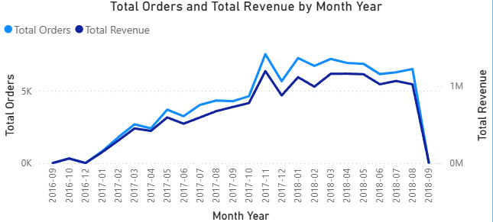
EXECUTIVE PERFORMANCE
TOTAL REVENUE
16.0M
TOTAL ORDERS
99K
TOTAL CUSTOMERS
96K
TOP REVENUE STATE
Sao Paulo (SP)
WHAT THIS TELLS US
Overall business performance is driven by revenue, order volume, customer reach, and regional performance. Monitoring these indicators helps identify growth areas and changes in sales momentum.

Slide 5
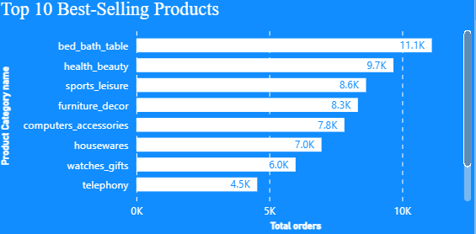
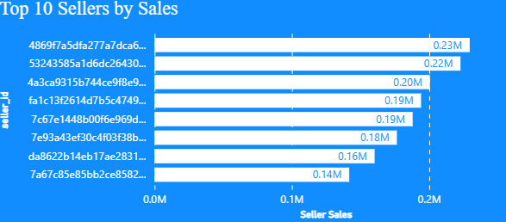
SALES & PRODUCT ANALYTICS
TOP PRODUCT CATEGORY
Bed bath Table
TOTAL SELLERS
3K
PRODUCT REVENUE
13.59K
Total Product Sold
113K
WHAT THIS TELLS US
Sales performance is concentrated among leading products and sellers. Identifying these key contributors helps the business focus on high-performing products and seller relationships.

Slide 6
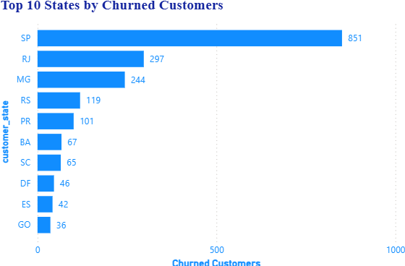
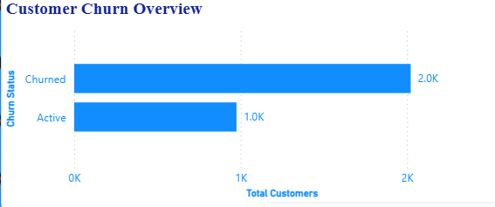
CUSTOMER & CHURN ANALYTICS
REPEAT CUSTOMERS
3K
ACTIVE REPEAT CUSTOMERS
975
ONE-TIME CUSTOMERS
93K
CHURN RATE
67.47%
WHAT THIS TELLS US
Most customers are one-time buyers, highlighting a strong opportunity to convert existing customers into repeat buyers. Churn analysis helps identify where retention efforts should be focused.

Slide 7
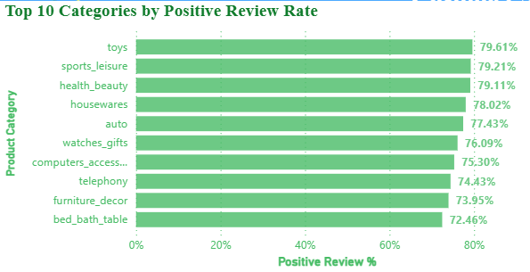
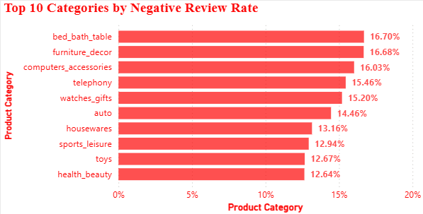
CUSTOMER SATISFACTION
TOTAL REVIEWS
98K
AVG REVIEW SCORE
4.10
POSITIVE REVIEWS
76K
NEGATIVE REVIEWS
14%
WHAT THIS TELLS US
Overall customer satisfaction is strong, but category-level differences highlight where product and service improvements can have the greatest impact.

Slide 8
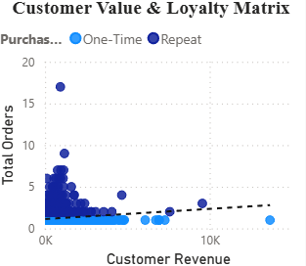
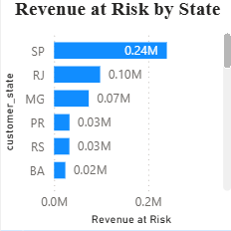
RETENTION & GROWTH OPPORTUNITIES
REVENUE AT RISK
615.47K
HIGH-VALUE CUSTOMERS
225
REPEAT CUSTOMER REVENUE
944.02K
REPEAT PURCHASE OPPORTUNITY
93K
WRECOMMENDED ACTIONS
Retain high-value customers
Prioritize customers generating higher revenue.
Convert one-time buyers
Use targeted offers to encourage a second purchase.
Focus on high-risk states
Prioritize retention efforts where revenue at risk is highest.
Strengthen repeat purchasing
Use customer behaviour and payment preferences to create targeted campaigns.

